Slide 1
Capstone 2 Deliverables
By: Eric Cadena

Slide 2

Background
This is an document created from anecdotal experience leading and partaking in production level machine learning projects.
I have combined the rubric originally intended for this Capstone with other industry terminology and my own logical progression for DS project.
This guide will include a rubric, associated deliverables, and template.
These due dates are general guidelines. Generally speaking, you should attempt to complete a deliverable/day until presentation day.
Please feel free to reach out if you have any questions in regards to this guide.

Slide 3
One Deliverable/Day
This is a common practice for 2 Week PoC (Proof Of Concept) Data Science Projects
This requires constant communication and work from all parties involved.

Slide 4
Deliverable | Description | Ideas for Delivery | Due Date
Project Profile | •Fill out the associated Google Form to collect project proposals from each student or group (2 pts) •Include sections for project title, problem statement, objectives, data sources, and proposed methodologies (essentially all the is included in the form). (1 pt) •Students should specify the machine learning techniques they plan to use and justify their choices. (1 pt) •Students should also provide a rough breakdown of tasks. (1 pt) | PPT, Google Slide | Dec 18, 2023
Data Map | •Develop a data map that outlines the structure and relationships within the dataset. (2 pts) •Identify key variables, their types, and potential challenges in the data. (2 pts) •Clarify how the data aligns with the project objectives and hypotheses. (1 pt) | ERD, PPT, Google Slides | Dec 19, 2023
Refined Data Map | •Update the data map based on feedback and additional insights gained during the initial stages of the project. (2 pts) •Specify any changes made to the data structure, variables, or relationships. (2 pts) •Ensure that the refined data map reflects a comprehensive understanding of the dataset. (1 pt) | ERD, PPT, Google Slides | Dec 20, 2023
EDA | •Conduct a thorough exploratory data analysis to understand the characteristics of the dataset. (2 pts) •Generate descriptive statistics, visualizations, and key insights about the data. (2 pts) •Identify patterns, trends, and potential outliers that may impact modeling decisions. (1 pt) This can be done by everyone simultaneously to look at different aspects of the data. Goal is to provide your understanding and what might be useful to add to the analysis/model. | Graphics, Stats, KPIs etc. on PPT, Google Slide, etc | Dec 22, 2023
Feature Engineering | •Implement feature engineering techniques to enhance the predictive power of the model. (2 pts) •Create new features or transform existing ones to better capture relevant information. (2 pts) •Explain the rationale behind each feature engineering step. (1 pt) Each student should contribute to which features will be important to use. Reminder you can use PCA to reduce the number of features as well. | ERD, PPT, Google Slides | Dec 23, 2023
Initial Modeling | •Build initial machine learning models using a subset of the data. (2 pts) •Experiment with different algorithms and hyperparameters. (2 pts) •Evaluate the performance of each model using appropriate metrics. (1 pt) Each student is responsible creating an initial model. | PPT. Google Slides, Code Snippets are OK if necessary, Diagram NN or Tree | Jan 2, 2023

Slide 5
Deliverable | Description | Ideas for Delivery | Due Date
Final Modeling and Performance Results | •Each student or group should produce at least one individual model, varying parameters or architecture. (5 pts) •Collaboratively decide on a final model based on the performance results from individual models. (2 pts) •Compare the final model's performance against benchmarks or industry standards. (2 pt) •Provide detailed documentation of the chosen model, including its strengths and limitations. (1 pt) |  | Jan 3, 2023
Final Model Comparison and Selection | •Compare the individual models based on metrics such as accuracy, precision, recall, and F1 score (or whatever metrics are reasonable for your problem). Custom metrics encouraged. (5 pts) •Discuss the trade-offs and considerations that led to the selection of the final model.(3 pt) •Justify why the chosen model is suitable for addressing the problem statement. (2 pts) |  | Jan 4th, 2023
Benchmarks | •Include benchmarks or baseline models to compare the performance of the final model. (2 pts) •Clearly state the criteria used for benchmark selection. (2 pt) •Analyze how the final model outperforms or compares to these benchmarks. (1 pt) Feel free to use your least performant models as benchmark if your research does not conclude that there are good benchmarks for your problem, field ect. |  | Misc
Software Version Control | •Repository created on GitHub. (2 points) •Files frequently committed to repository. (3 points) •Commit messages with appropriate level of detail included. (2 points) •Repository organized, and relevant information and project files included. (3 points) Failure to have commits to your groups repo is considered non-contributory and will result in no grade for the associate student. Advice - if GitHub/Git are an issue, create a folder with just your work and commit only to this folder. Do not run each others code. Don’t even open the Jupyter Notebooks. You still need to frequently commit to this folder no matter. SAVE/COMMIT YOUR CODE DAILY. |  | Misc
Documentation | •Code is well commented with concise, relevant notes. (5 points) •GitHub README.md file includes a concise project overview. (2 points) •GitHub README.md file includes detailed usage and installation instructions. (3 points) •GitHub README.md file includes either examples of the application or the results and summary of the analysis. (5 points) Reminder - for some people, this is the first and last time an employer might see your work, i.e. they may only look at the front page of your repository (README) and nothing more so it needs to look good. |  | Misc

Slide 6
Deliverable | Description | Ideas for Delivery | Due Date
Presentation | Proposal/Project Profile - An executive summary of the project and project goals. (3 points) •Explain how this project relates to fintech and machine learning. Include information about your Project Proposal Data Map, EDA, & Feature Engineering - The data preparation. (3 points) •Describe the source of your data and why you chose it for your project. •Describe the collection, cleanup, and preparation process. •Describe the EDA you performed to further your understanding of the data through statistics that informed the feature engineering selection process. •Describe the features you decided to use and why a machine learning model would benefit from utilizing this information. The approach that your group took to achieve the project goals. (5 points) •Include any relevant code or demonstrations of the machine learning model. •Describe the techniques that you used to evaluate the performance of the model. •Discuss any unanticipated insights or problems that arose and how you resolved them. Initial Models/Final Models/Performance Results - The selected model. (2 points) •Describe the machine learning model that your group selected and why. •Describe the various models used, why they might have been used, their architectures and any other relevant information. •Describe why you chose the final model and the associated performance metrics and why they are pertinent The final results and conclusions from the machine learning model or application. (5 points) •Include relevant images or examples to support your work. •If the project goal wasn’t achieved, share the issues and what the group tried for resolving them. Failing at experiments or not showing Proof of Life or Proof of Concept is a perfectly fine outcome to a scientific endeavor, especially in an academic environment but usually less so within business contexts. Next steps. (1 points) •Take a moment to discuss the potential next steps for the project. •Discuss any additional questions that you’d explore if you had more time. Specifically, if you had additional weeks to work on your project, what would you research next? Investment/Project Cost(s) (1 points): •Start thinking about the following - how much would it cost to take a project like this to production/to-scale? At minimum, what would it cost for you and your team to be on the project (minus nuances of overhead and other costs). Research your "role", what it is currently called in the field, and the associated salary. Add this up across your team members and, if this project (getting more data, standing up the appropriate infrastructures, and getting the desired results for the client) was to run for 6 months, what would it cost to hire you and your team? How much does it cost to hire you? Extra credit if you can speak about ROI or some sort of return on investment. 10 mins, Hard Stop. 2 - 3 Q&A. | PPT, Google Slides, Demonstration of Product | Dec 6th, 2023

Slide 7
Capstone 2 Google Form
Link or https://forms.gle/YqNoCkNkLw3xfVdh7

Slide 8
Templates
Example templates for deliverables. Please change for your presentation and to tell your story.

Slide 9
Project Profile
Project
The Trend is Your Friend
Business Objectives
Names
Etienne, Donya, James
Establish a trading algorithm to identify position entries given live stock market data. End user would utilize entry signals based on predictive machine learning models.
Industry
FinTech - Algorithmic Trading
Data Sources & Feasibility
Alpacas’ API - QQQ 5 min stock data post GameStop Trading Event
Create new daily data frames from polynomial data smoothing to be used by neural networks.
Analytical Potential & Feasibility
Double tops/bottoms are an already well established trading pattern with a quoted “78% success rate”.
Model testing our algorithm to identify double tops/bottoms via polynomial fit (data smoothing) on daily Stockmarket data.
Create machine learning model to identify double tops/bottoms on the data.
Utilize new data, for hypothesis testing, to identify predictive effectiveness of of the machine model.
Business Value
At the moment this project can be viewed as experimental testing of a hypothesis. However, if the algorithmic trading hypothesis is identified to be successful then automated trade entry signals, based on predictive analytics, can give traders an edge that technical analysis alone does not provide. The “trading edge” is that double top/bottom signals will not be missed and predictive entries will be given with a time advantage.

Slide 10
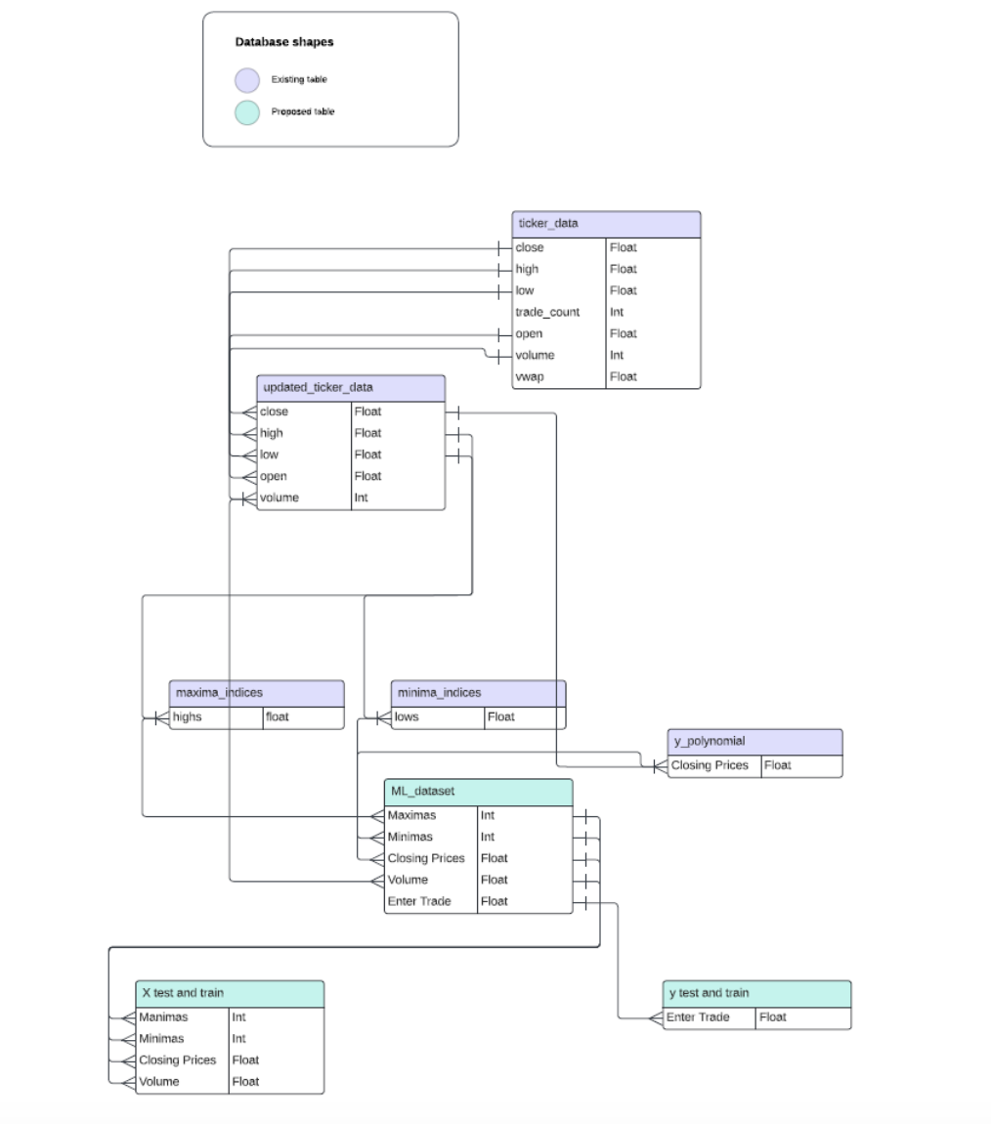
Data Map

Slide 11
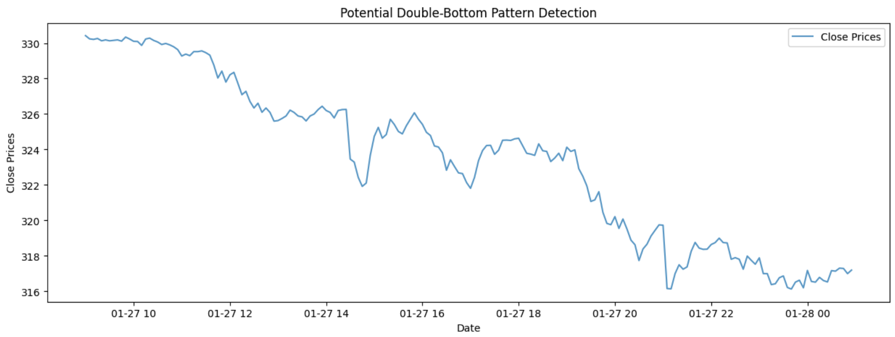
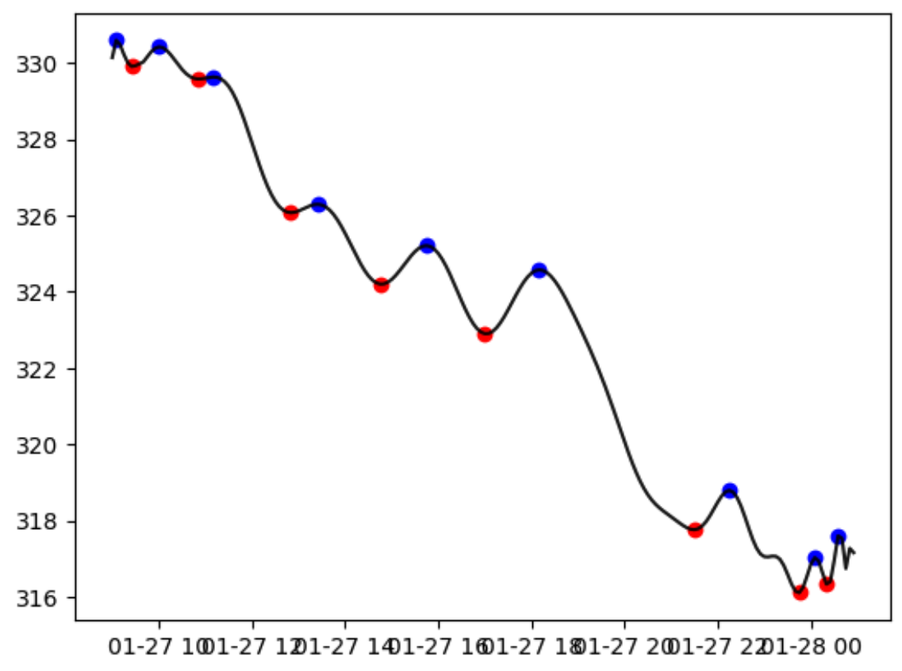
EDA
Pattern Identification
Double top/bottom patterns are technical reversal patterns that form after an asset reaches a high/low price two consecutive times with a moderate decline/incline between the two high/lows.
These patterns are not always easy to spot because there needs to be confirmation with break below support.
Key Elements of a Double Top/Bottom:
Up/down-trend: price should clearly be moving in an up or down direction.
b. Valley for double top pattern, or peak for double bottom pattern.
c. Neckline break: horizontal line that is created at the respective.
d. Break of Neckline: price drop below/above horizontal neckline. Initiate trigger.
QQQ Data w/ Polynomial Fit & localized Min/Max
Extrapolating Local Minima & Maxima
Daily 5 minute OCHL stock data is to be smoothed via a polynomial fit line in order to easily identify local minima/maxima and Numpy features utilized to establish. Closed polynomial fit data will be used to identify the local minima/maxima as standard day trading practice uses candle close data
Double Top
B
Defining Pattern Parameters & Assigning Feature Data
D
Double Top Variables:
x_n = time (x-axis) to establish the pattern
A = positive slope leading up to local max
B = first test local max
C = first local min immediately following A
D = 2nd max within test of B tolerances
E = break below C (candle close)
Time scale: x = x_E - x_0
A = (how do we initiate??)
B > A
C < B
D > C and low < D < high
E = C and close < C
Initiate Trigger/Signal
A
E
C

Slide 12
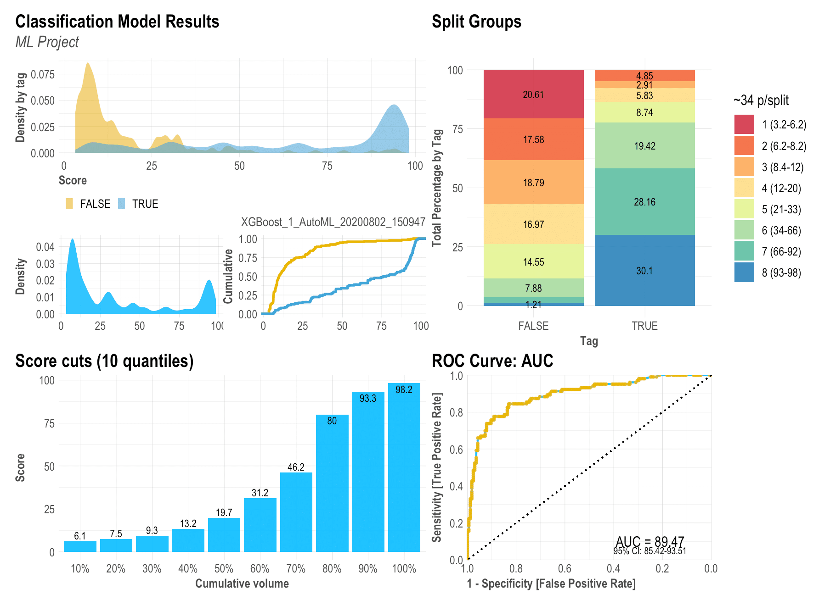
Initial and Final Model Selection (+Benchmarks)
Reminder - this is a TEMPLATE. Please use this as a source of inspiration and transform this into a deck of your own.
Reminder - Try to showcase all the models you used and why you ended up with the final model. Ensure you weave in the messaging of benchmarks and why they might be important here.
Please remove this before using this slide.

Slide 13
Closing Remarks
Reminder - this is a TEMPLATE. Please use this as a source of inspiration and transform this into a deck of your own.
Reminder - Again, this is just a template. Add, take away, create another slide to fit or point out more info. Totally up to you.
Please remove this before using this slide.
Conclusions
Key takeaways/Conclusions
Next Steps/Investment or ROI

Slide 14

Closing Remarks
This capstone can be a certain point to your portfolio of projects - take it seriously!
Ensure you are keeping communication with all your group mates. Lack of communication is the #1 risk factor for failure in most projects.
Adhere to deadlines as best as possible.
Deliverables can be auditied by instructional staff at any point.
You need not submit anything other than your final project presentation (which should include everything) to the Instructor via Canvas.
It is generally good practice to stay accountable to one another - your deliverables are due to your team on the due dates.
If issues arise with group mates please communicate with instructional staff ASAP.

